Slide 1
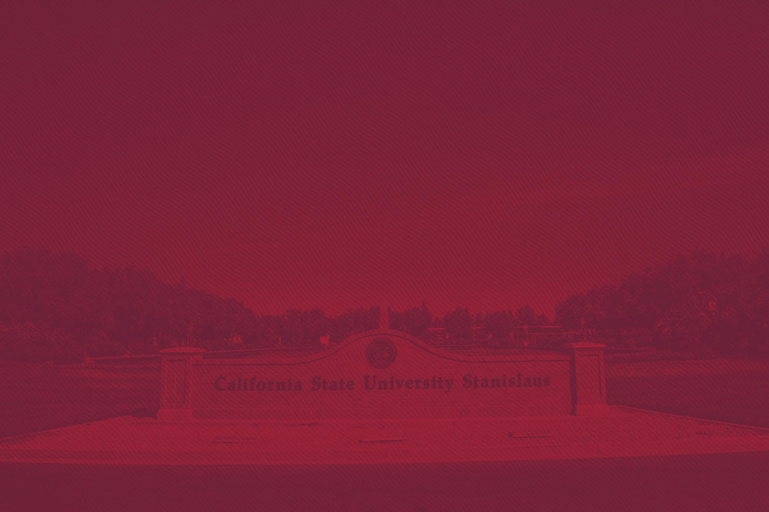


Summer Research Week!!!
Dr. Cash Bortner (Math)

Slide 2

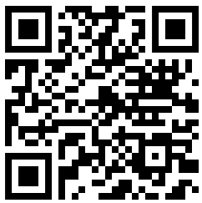

Why Summer Research?
Research Experiences for Undergraduates (REUs):
Run 6-10 weeks at universities all over U.S. and provide:
Research experience in science labs!
Money ($3,000-$7,000)
Travel, lodging, and meals
Professional development: prep for grad school/career
Mentors/Friends for life!

Slide 3
Types of Programs
At Stan State: paid research with faculty
- McNair, ASPIRE, SERSCA, Cal-Bridge, Other
National Science Foundation REU Program
National Labs
Other Programs:
- Amgen Scholars (biotech)
-Pathways to Science Database
-Programs without Residency Requirements

Slide 4
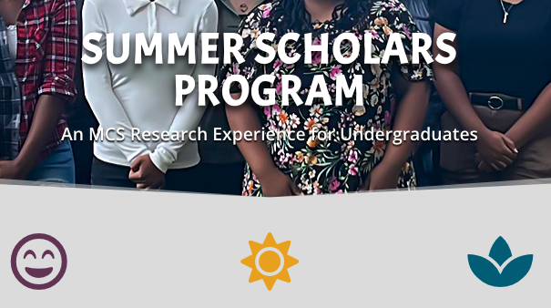
Summer Research Examples
Carnegie Mellon Summer Scholars Program

Slide 5
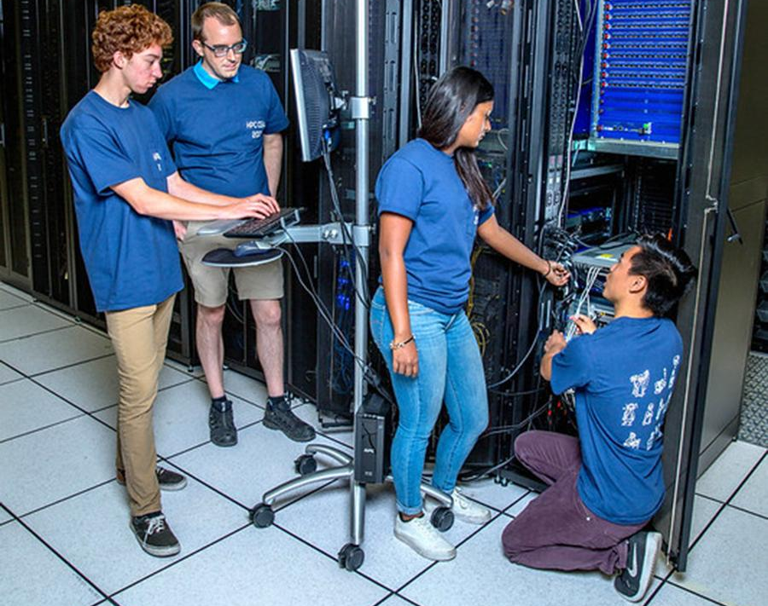
Summer Research Examples
Lawrence Livermore National Lab

Slide 6

Eligibility
Most REUs (funded by NSF):
U.S. citizen or permanent resident
Currently enrolled undergraduate
Usually for sophomores and juniors (more than one year of college done, but not graduating)*
-*National Labs area slightly different

Slide 7
Application Procedures
Deadlines: January-February
Application Form (personal info)
Personal Statement (1-2 pages)
-Personal Background
-Research Interests
-Academic Goals
Letters of Recommendation (~2)
Resume/CV + Transcript

Slide 8
Your Application Plan
Before winter break:
-Talk to two professors for letters of recommendation
-Create a list (spreadsheet) of potential programs
Over Winter Break
-Finalize list of programs
-Write personal statements, get feedback from everyone!
Apply before deadlines!!!

Slide 9

Stan State Student Experience!

Slide 10
Questions?????

Slide 11
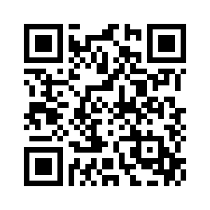
This Presentation!

